Slide 1
HW 4
Mark Gameng, Seat 23, mgameng1@hawk.iit.edu

Slide 2
Counting Sort
Essentially counting sort takes in values to be sorted and count the occurrences in an auxiliary array with the index corresponding to the actual value. The size of the auxiliary depends on the range, or highest value of the array.
For it to do that, it iterates through the array, (n), and fills up the auxiliary array with the number of occurrences of the values
Then, it loops through the auxiliary array, (range), and updates the array, essentially sorting it, using the count and the index of the auxiliary array.
Thus, the time complexity is just O(n + range), with range being the range of the values in the array. For example, if the values are just from 1 – 100, the range/size of the auxiliary array is just 100.

Slide 3
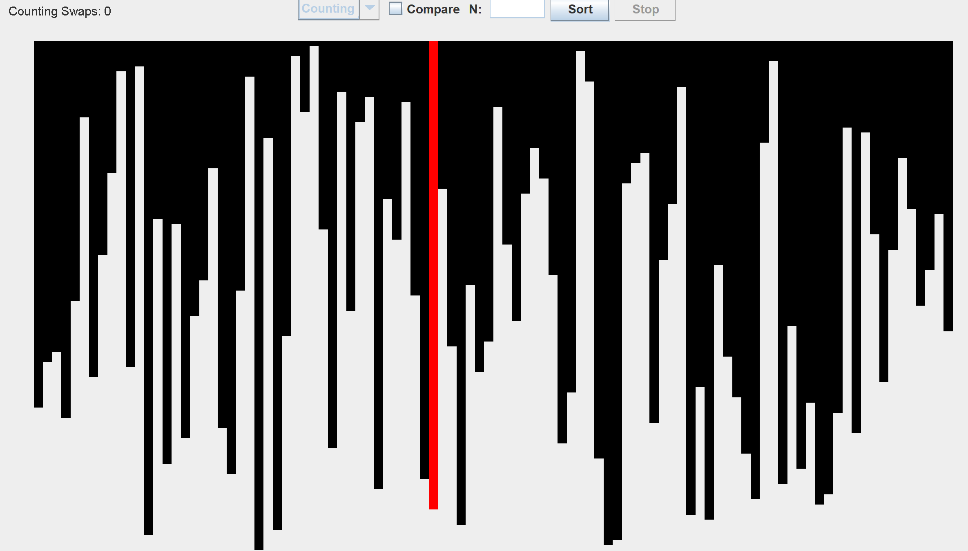
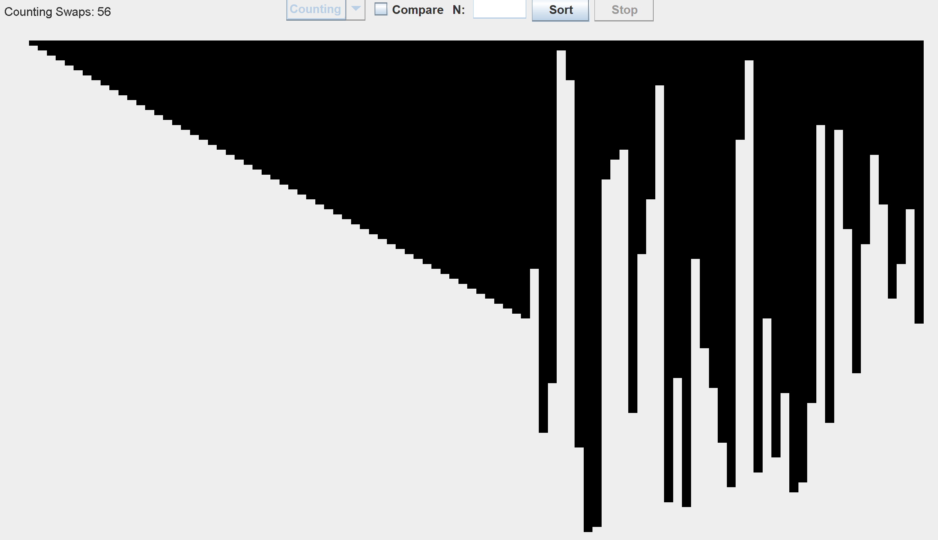
Counting Sort cont.

Slide 4
Radix Sort
Radix sort sorts digit by digit starting from the least significant digit. It’s similar to counting sort but is more for larger numbers.
It essentially does counting sort but for each digit of the values.
So, it would be O(#digits * (n + range)). But in this case, the range would just be 10, because the digits can only be from 0 – 9.
The #digits depends on the maximum value in the array, which is just log(max)
Thus, the time complexity is just O(log(max)*(n+10)) which can just be simplified to O(nlog(max)).

Slide 5
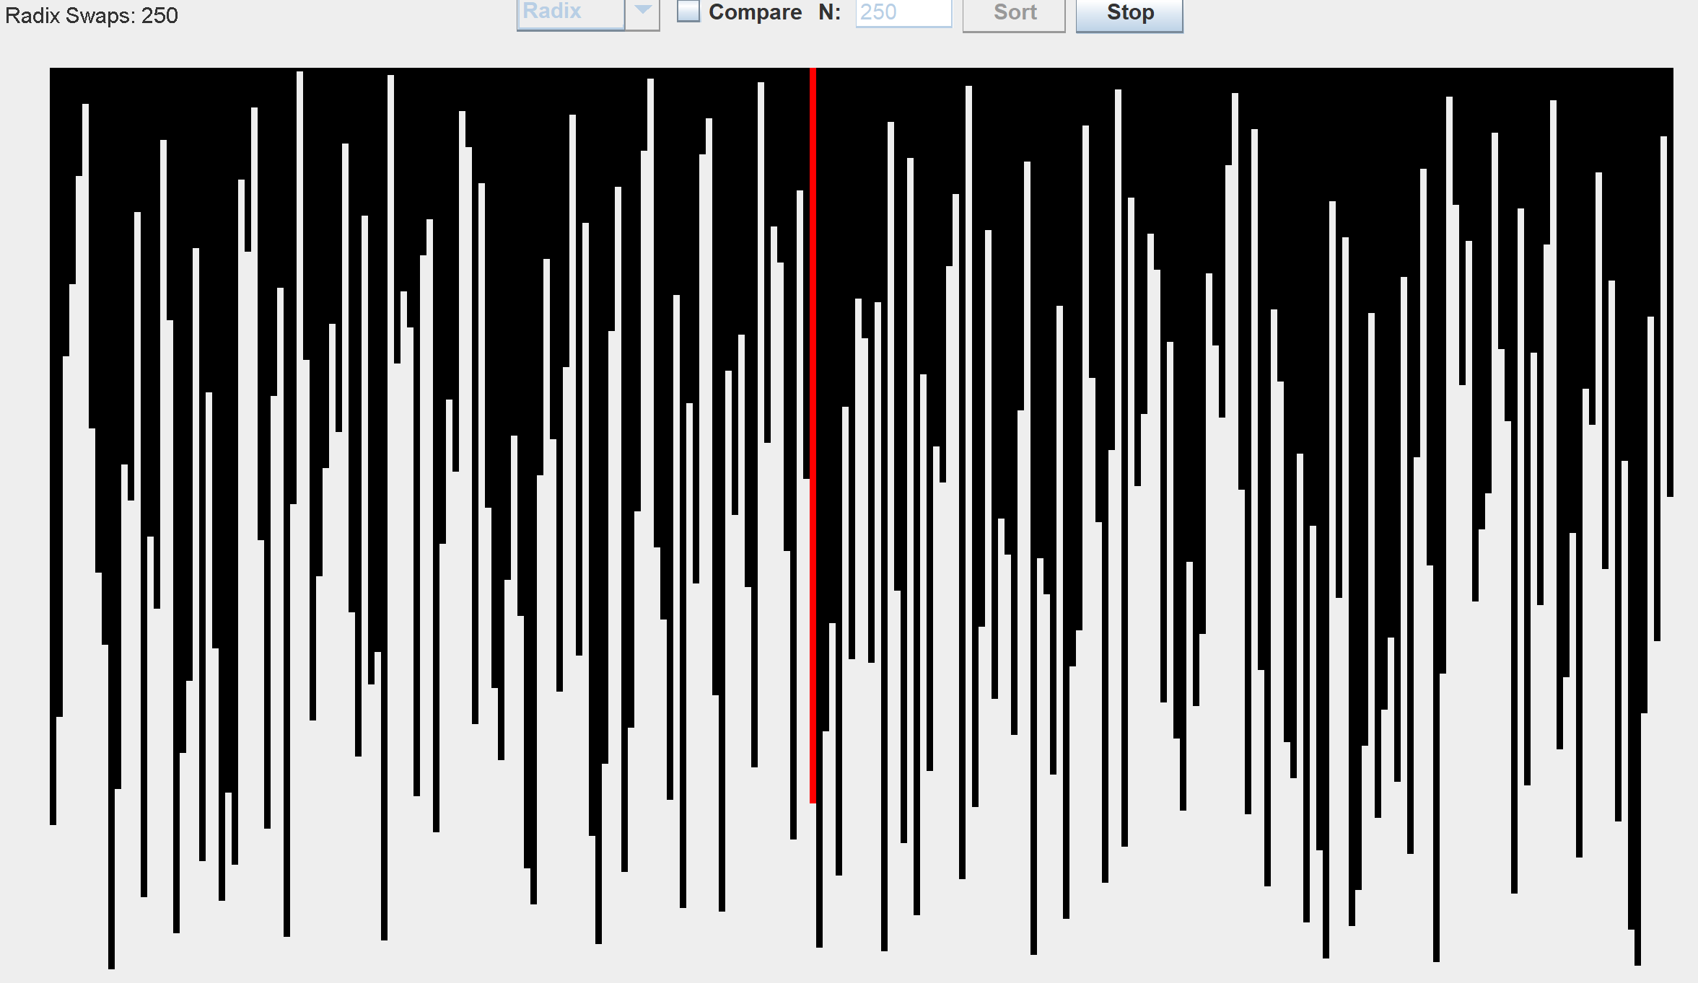
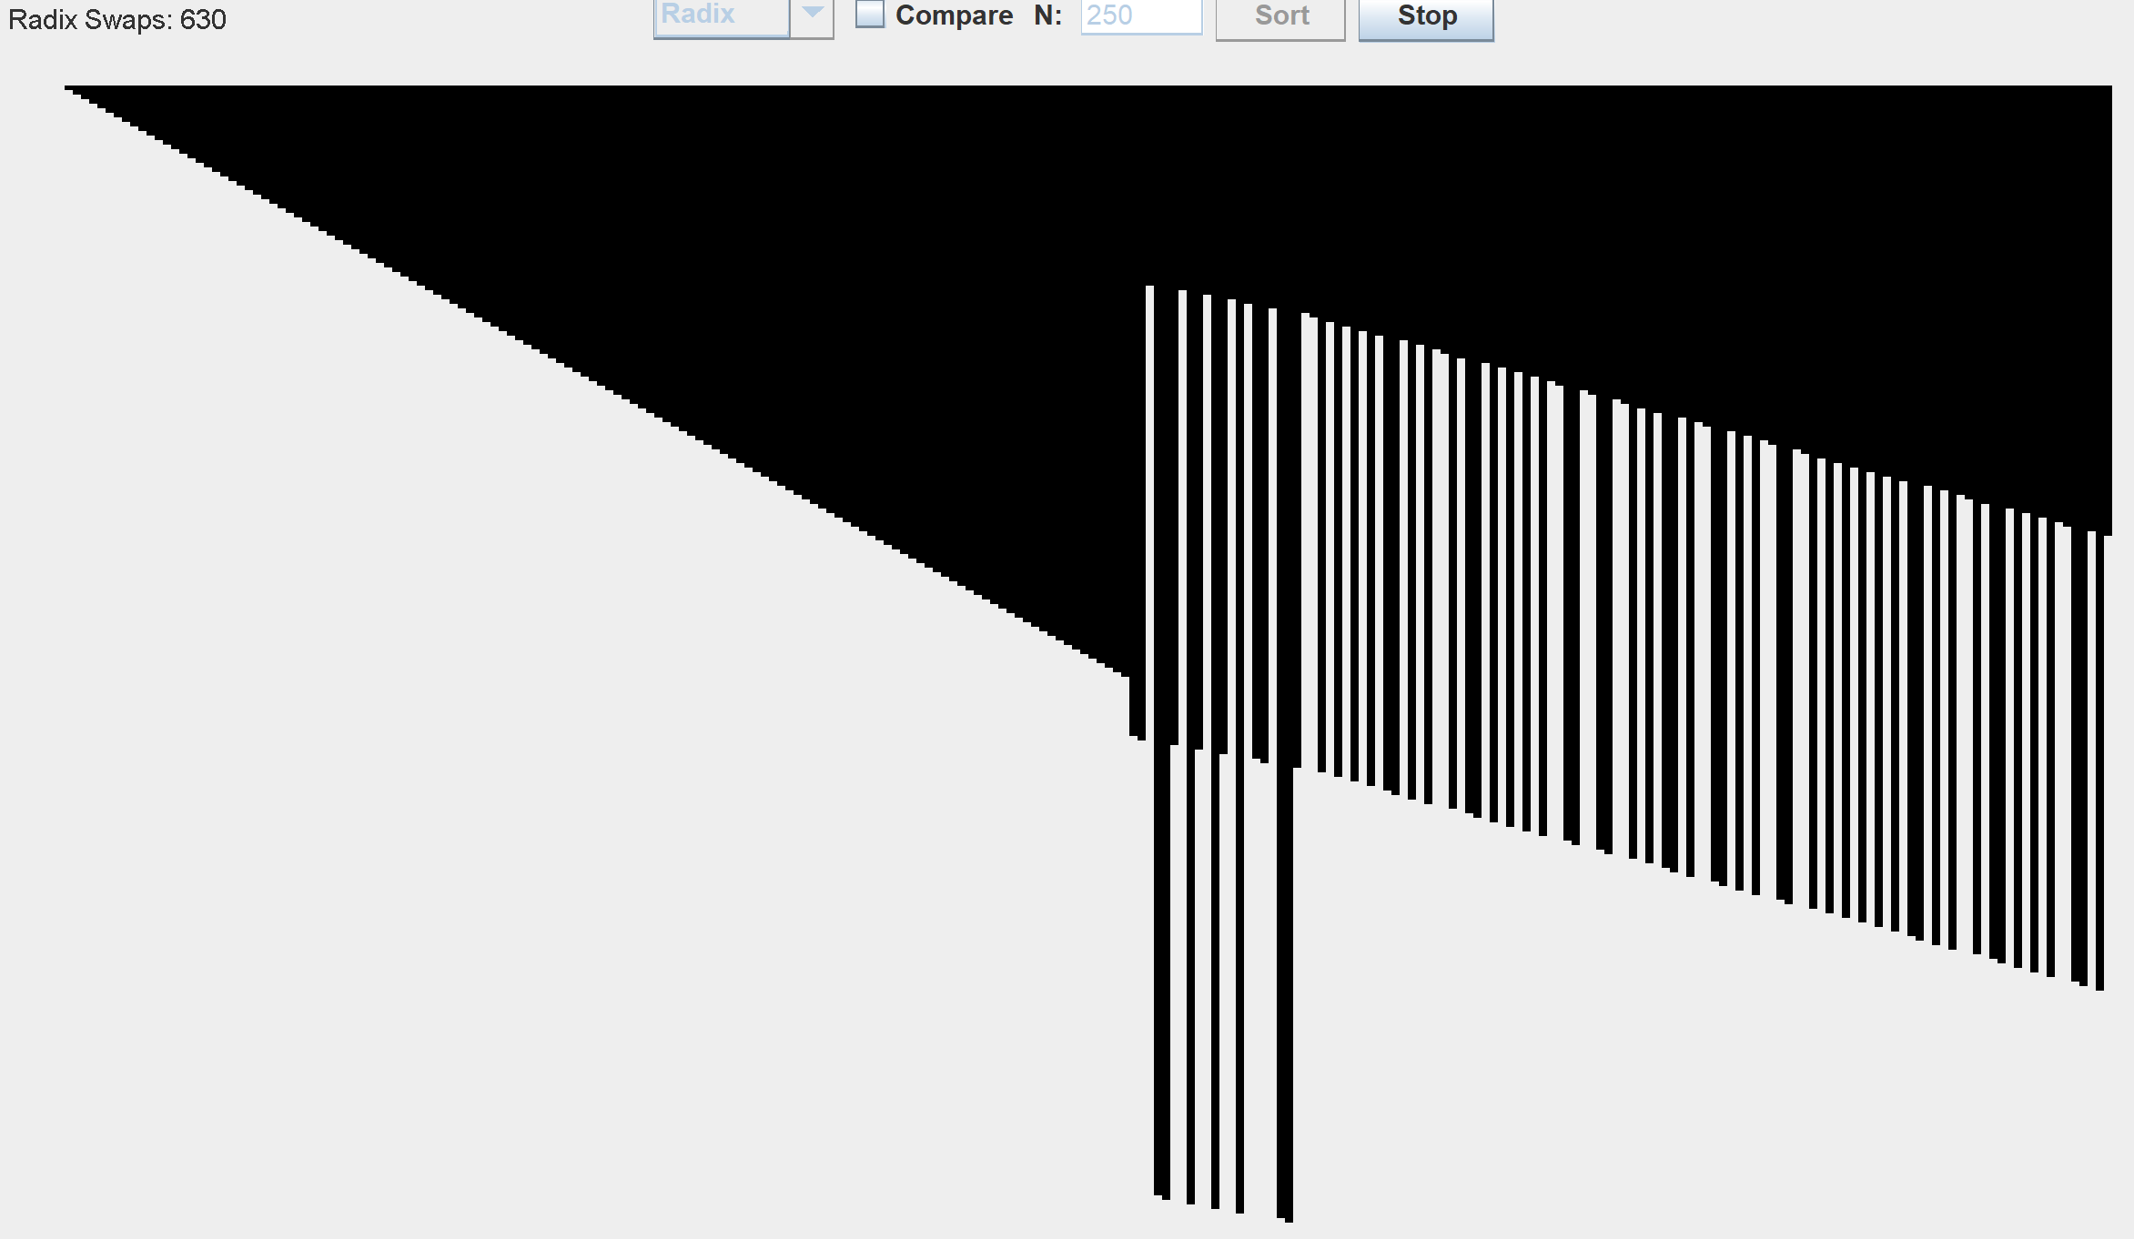
Radix Sort cont.

Slide 6
Comparing
Comparing the two, Counting sort is faster than Radix sort when dealing with lower valued numbers, but when the values/range of the numbers is really high, then Radix sort would do better
This holds true in my program for the lower valued numbers, but for higher valued numbers, couldn’t test it as my program can’t handle the range of 1 to thousands or millions of numbers
Counting sort is linear time, O(n+range) when elements have values ranging from 1 to range. However if the elements from 1 to x^2, then counting sort would take O(n^2). Thus, for higher ranges/values, radix sort is better.

Slide 7
Program Instructions
Choose the algorithm you want to see and click sort
Change the size of array, by typing an number in text field
Click stop if you want to
Click compare if you want to keep arrays the same for each algorithm so you can compare
For radix and counting sort, red bars means that element was accessed. I added this because otherwise, it wouldn’t be clear what the algorithm was doing, and it would just instantly sort the array.

